Slide 1
Lecture 19
Telephony Manager

Slide 2
Introduction
Telephony Manager provides access to information about the telephony services on the device.
android.telephony.TelephonyManager class provides information about the telephony services such as:-
1. IMEI number
2. Subscriber ID
3. SIM Serial number
4. Network Country
5. SIM Country
6. Network Operator
7. SIM Operator
8. Network Operator Name
9. SIM Operator Name
10. Software Version
11. Voice Mail Number
12. Phone Network Type (GSM/CDMA/None)
13. Roaming Status (True/False)
etc……..

Slide 3
Example of Telephony Manager
Make a Project by name TelephonyApp.
Take a Text-View in your Layout XML File.
Code of MainActivity.java:-
public class MainActivity extends Activity {
TextView tv;
protected void onCreate(Bundle savedInstanceState) {
super.onCreate(savedInstanceState);
setContentView(R.layout.activity_main);
tv = (TextView)findViewById(R.id.textView1);
//Make object of TelephonyManager
TelephonyManager tm = (TelephonyManager)getSystemService(Context.TELEPHONY_SERVICE);

Slide 4
Code of MainActivity.java
//Calling the methods of TelephonyManager the returns the information
String IMEINumber=tm.getDeviceId();
String subscriberID=tm.getSubscriberId();
String simSerialNumber=tm.getSimSerialNumber();
String networkCountryISO=tm.getNetworkCountryIso();
String simCountryISO=tm.getSimCountryIso();
String networkOperator = tm.getNetworkOperator();
String simOperator = tm.getSimOperator();
String networkOperatorName= tm.getNetworkOperatorName();
String simOperatorName = tm.getSimOperatorName();
String softwareVersion=tm.getDeviceSoftwareVersion();
String voiceMailNumber=tm.getVoiceMailNumber();

Slide 5
Code of MainActivity.java
//Get the phone type
String strphoneType = " ";
int phoneType=tm.getPhoneType();
switch (phoneType)
{
case TelephonyManager.PHONE_TYPE_CDMA:
strphoneType = "CDMA";
break;
case TelephonyManager.PHONE_TYPE_GSM:
strphoneType = "GSM";
break;
case TelephonyManager.PHONE_TYPE_NONE:
strphoneType = "NONE";
break;
}
//getting information if phone is in roaming
boolean isRoaming = tm.isNetworkRoaming();

Slide 6
Code of MainActivity.java
// Put all values in a String
String info="Phone Details: \n" +
“ \n IMEI Number: " + IMEINumber +
“ \n SubscriberID: " + subscriberID +
“ \n Sim Serial Number: " + simSerialNumber +
“ \n Network Country ISO: " + networkCountryISO +
“ \n SIM Country ISO: " + simCountryISO +
“ \n Network Operator Number : " + networkOperator +
“ \n SIM Operator Number: " + simOperator +
“ \n Network Operator Name : " + networkOperatorName +
“ \n SIM Operator Name : " + simOperatorName +
“ \n Software Version: " + softwareVersion +
“ \n Voice Mail Number: " + voiceMailNumber +
“ \n Phone Network Type: " + strphoneType +
“ \n In Roaming? : " + isRoaming ;
//displaying the information in the textView
tv.setText(info);
}
}

Slide 7
Take a Permission in AndroidManifest.xml
<uses-permission android:name="android.permission.READ_PHONE_STATE"/>

Slide 8
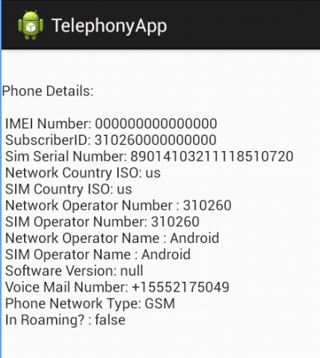
Output

